Slide 1

Data Structures
Module Number: 2.1
Module Name: Stack and its Applications
Version: DSA3
Released Date : 2-AUG-2018

Slide 2
Stack and its Applications
AIM
To know about the Stack Data Structure

Slide 3
Stack and its Applications
Objective of This Module
To know about the stack data structure
To understand the basic concepts and operations
To know how to access the elements in stack

Slide 4
Stack and its Applications
Outcome of This Module
To develop a stack data structure
Accessing the elements in stack
To perform different operations on stack
To understand the applications in which stack data structure can be used.

Slide 5

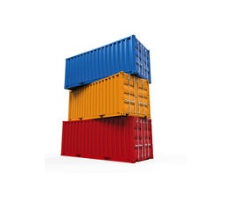
Stack and its Applications
Examples from real life
.
Stack of Books
Stack of containers
Figure 2.1.1 : Examples of stack from real life
Notes:
As shown in slide we have taken two example from real life that illustrates stack data structure.
Stack of books placed one over another.
Stack of containers
As shown in figure of containers first red container is placed then orange over it and in last blue container. But if we want to access red container then first Blue container has to be removed then orange and then red. It means Blue container which was placed in last has to be removed first this strategy is called LIFO (Last in first out)

Slide 6
Stack and its Applications
Stack- Definition
A stack is a LIFO structure and physically it can be implemented as an array or as a linked list.
A stack implemented as an array inherits all the properties of an array and if implemented as a linked list.
An insertion in a stack is called pushing.
A deletion from a stack is called popping.

Slide 7
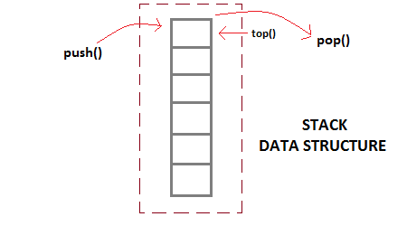
Stack and its Applications
Representation of Stack
Stack is an abstract data type with a bounded (predefined) capacity. It is a simple data structure that allows adding and removing of elements in a particular order.
Figure 2.1.2: Stack Data Structure

Slide 8
Stack and its Applications
Features of Stack
1. Stack is an ordered list of similar data type
2. Stack is a LIFO structure. (Last in First out). Here, the element which is placed last, is accessed first
3. push() function is used to insert new elements into the Stack and pop() is used to delete an element from the stack. Both insertion and deletion are allowed at only one end of Stack called Top
4. Stack is said to be in Overflow state when it is completely full and is said to be in Underflow state if it is completely empty

Slide 9
Stack and its Operations
Stack Specification
Definitions: (provided by the user)
MAX_ITEMS: Max number of items that might be on the stack
ItemType: Data type of the items on the stack
Operations
MakeEmpty
Boolean IsEmpty
Boolean IsFull
Push (ItemType newItem)
Pop (ItemType& item)
Notes:
These are pseudo code definitions that could b implemented in any technical languages
We have implemented them using C++.

Slide 10
Stack and its Operations
Push (ItemType newItem)
Function: Adds newItem to the top of the stack.
Preconditions: Stack has been initialized and is not full.
Post-conditions: newItem is at the top of the stack.

Slide 11
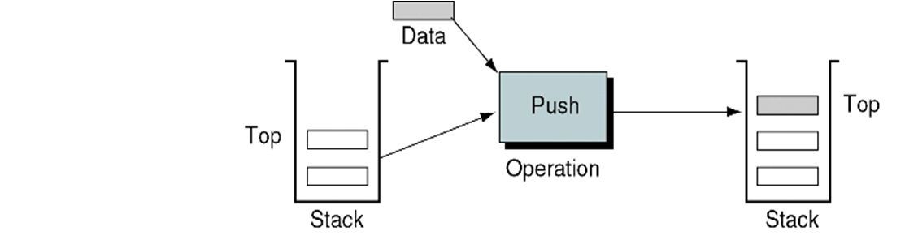
Stack and its Operations
Figure 2.1.3: Push operation on stack

Slide 12
Stack and its Operations
Pop (ItemType & item)
Function: Removes topItem from stack and returns it in item.
Preconditions: Stack has been initialized and is not empty.
Post-conditions: Top element has been removed from stack and item is a copy of the removed element.

Slide 13
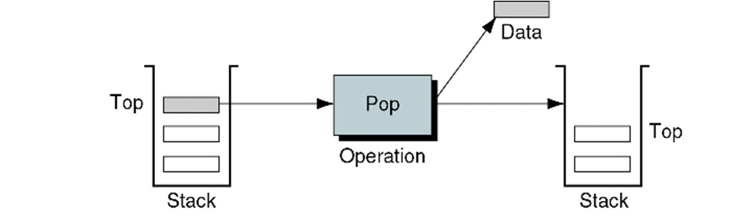
Stack and its Operations
Figure 2.1.4: Pop operation on stack

Slide 14
Stack and its Operations
StackTop (ItemType & item)
Function: returns topItem from stack and returns it in item.
Preconditions: None
Post-conditions: No Changes

Slide 15
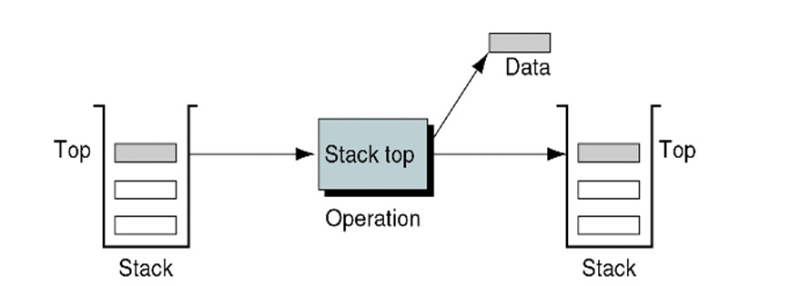
Stack and its Operations
Figure 2.1.5: Stack top operation on stack

Slide 16
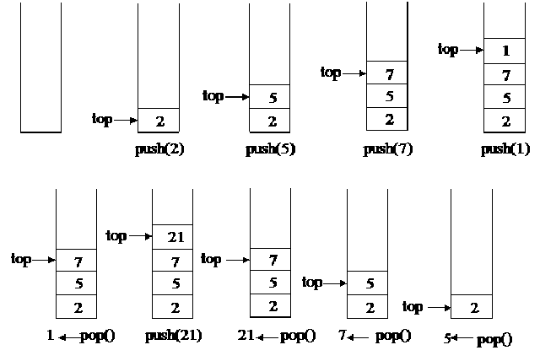
Stack and its Operations
Step 1
Step 2
Step 3
Step 4
Step 5
Step 6
Step 7
Step 8
Step 9
Step 10
Figure 2.1.6 : Stack Operations
Notes:
Explanation of Figure
Step 1 : Shows empty stack. top pointer is initialized to -1.
Step 2 : Shows push(2) operation it means value 2 is inserted on stack.
For push operation to take place top pointer is incremented by 1 then value is inserted on place indexed by top pointer.
Step 3 : shows push(5) operation value 5 is pushed on top of stack
Step 4: shows push(7) operation value 7 is pushed on top of stack
Step 5: shows push(1) operation value 1 is pushed on top of stack
Step 6: shows pop() operation.
Value indexed by top pointer is removed (i.e. value 1 is removed and returned )
top pointer is decremented by 1.
Step 7: shows push(21) operation value 21 is pushed on stack
Step 8: shows pop() operation value 21 is returned and removed from stack.
Step 9: shows pop() operation value 7 is returned and removed from stack.
Step 10: shows pop() operation value 5 is returned and removed from stack.

Slide 17
Stack and its Applications
Stack Implementation (Using C++)
#include "ItemType.h"
// Must be provided by the user of the class
// Contains definitions for MAX_ITEMS and ItemType
class StackType {
public:
StackType();
void MakeEmpty();
bool IsEmpty() const;
bool IsFull() const;
void Push(ItemType);
void Pop(ItemType&);
private:
int top;
ItemType items[MAX_ITEMS];
};
Notes:
In code shown above class name StackType is defined
It is defined to implement stack and its operations.
File named ItemType.h must be defined and included by the programmer. This file contains definitions of MAX_ITEMS ( Size of Stack: as stack is implemented using arrays) and ItemType (data structure for stack elements)
variable of type int, top, is used to denote top pointer.
Stack is implemented as array by the name items[]

Slide 18
Stack and its Applications
StackType::StackType()
{
top = -1;
}
void StackType::MakeEmpty()
{
top = -1;
}
bool StackType::IsEmpty() const
{
return (top == -1);
}
Notes:
StackType() constructor is used to initialize the top pointer by -1
MakeEmpty() method is used to make the stack empty by re-initializing the position of top pointer by value -1
IsEmpty() method is used to check whether the stack is empty or not. It checks by checking the condition top==-1 if it is true it returns true otherwise false

Slide 19
Stack and its Applications
bool StackType::IsFull() const
{
return (top == MAX_ITEMS-1);
}
void StackType::Push(ItemType newItem)
{
top++;
items[top] = newItem;
}
void StackType::Pop(ItemType& item)
{
item = items[top];
top--;
}
Notes:
IsFull() method is used to check whether the stack is Full or not. It checks by checking the condition top==MAX_ITEMS-1 if it is true it returns true otherwise false
Push(ItemType newItem) methods removes the value on top of stack.
It’s a two step procedure:
First value on top of stack as pointed by top pointer is removed and assigned to variable item
Then top is decremented by one to index top of stack.
Pop(ItemType& Item) methods takes single argument of type ItemType and inserts the value on top of stack.
It’s a two step procedure:
First top pointer is incremented by 1 to index next position
Then inserts the value at that position.

Slide 20
Stack and its Applications
Stack overflow
The condition resulting from trying to push an element onto a full stack.
if(!stack.IsFull())
stack.Push(item);
Stack underflow
The condition resulting from trying to pop an empty stack.
if(!stack.IsEmpty())
stack.Pop(item);

Slide 21
Stack and its Applications
Representation of Stack as an ADT
A stack is an Abstract Data Type that serves as a collection of elements.
Two operations:
Push - which adds an element to the collection.
Pop - which removes the most recently added element that was not yet removed.

Slide 22

Stack and its Applications
Quiz
1) A stack is works on the principle of ___________
a) First in first out (FIFO) c)First in last out (FILO
b) Last in last out (LILO) d)Cyclical data structures
2) The difference between linear array and stack is that any elements can randomly be accessed.
True b) False
3) Top[s] returns ________________
a) Stack bottom c) Stack mid
b) Stack top d) Any random element
Notes:
Question Number Answer Key
1 c
2 b
3 b

Slide 23
Stack and its Applications
Quiz
4) Match the following
1 | stacktop() | A | Used for checking if stack is empty
2 | Isfull() | B | Used for displaying topmost element
3 | Isempty() | C | Used for checking if stack is full
5) What push(x) does to stack
Removes x from stack c) Add x to all the elements
Add x to topmost element d) Add x to top of stack
6) What pop() does to stack
a) Removes x from stack c)Add x to all the elements
b) Add x to topmost element d)Add x to top of stack
Notes:
Question Number Answer Key
4 1 –b,2-c,3-a
5 b
6 a

Slide 24
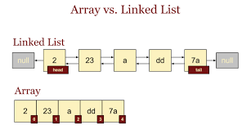
Stack and its Applications
Array and Linked List Representation
Linked list is a linear collection of data elements, in which linear order is not given by their physical placement in memory.
Each element points to the next. It is a data structure consisting of a group of nodes which together represent a sequence.
Figure 2.1.7: Array Vs. Linked List

Slide 25
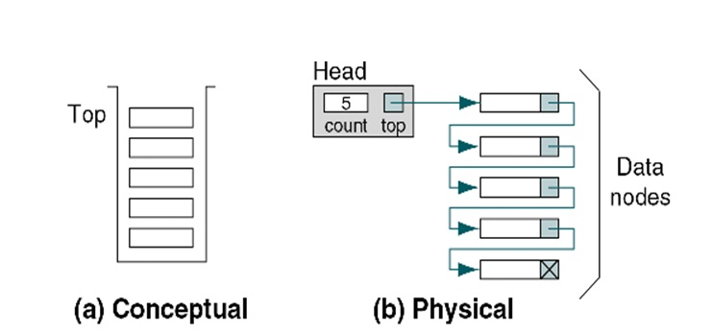
Stack and its Applications
Figure 2.1.8 : Conceptual Vs Physical Stack Implementation

Slide 26
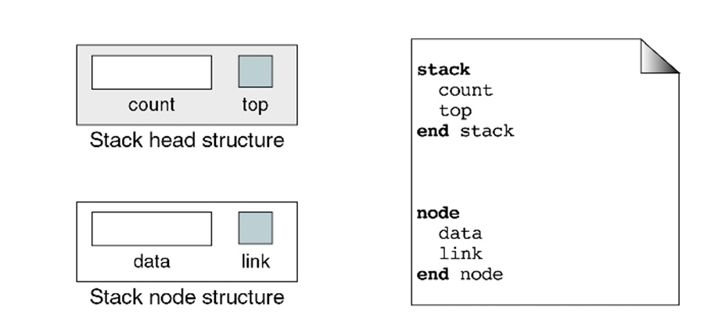
Stack and its Applications
Figure 2.1.9 : Data Structure used in Stack implementation using Linked List
Notes:
This figure shows the data structure used to implement stack using linked list
Linked List Header: Linked List header will contain two entities count and top
a) count will keep total count of values currently available
b) top will keep the address of node on top of stack
Node structure: Node contains two entities data and link
a) data keeps the value
b) links keeps the address to next node on top of it

Slide 27
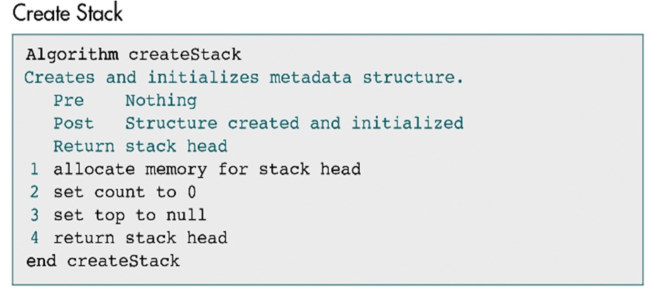
Stack and its Applications

Slide 28
Stack and its Applications
Head
count
0
top
NULL
top = NULL
Physical Implementation
Logical Implementation
Figure 2.1.10: Logical and Physical implementation of empty stack using linked list
Notes:
Steps for implementing stack using linked list as shown in figure:
Step 1. Empty Stack is created
Memory is allocated to Head
Count is initialized to 0
top is initialized to NULL

Slide 29
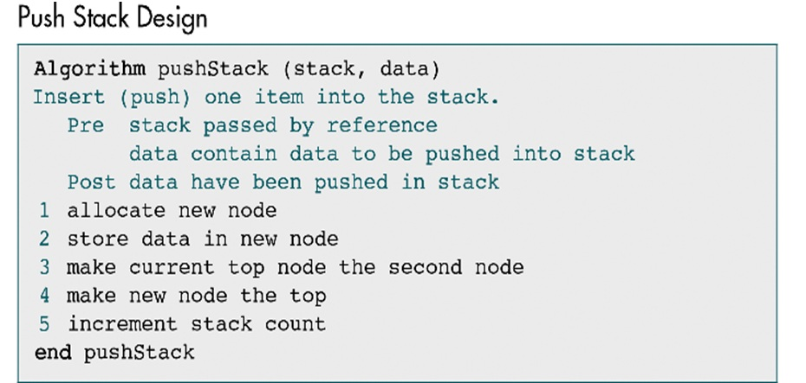
Stack and its Applications

Slide 30
Stack and its Applications
Physical implementation
Head
Temp
Head
Temp
count
0
count
1
top
NULL
Node
top
Node
data
5
data
5
link
NULL
link
NULL
Head is updated :
top = temp
count++
free(Temp)
First node created using push(100) operation
Figure 2.1.11: Implementation of Push operation on stack using linked list
Notes:
Steps for implementing stack using linked list as shown in figure:
Step 2. First Node is create using Temp pointer
Value is inserted in data
NULL is assigned to link
Step 3. Head is updated
Address of first node is assigned to top
count is incremented by 1

Slide 31
Stack and its Applications
Pop Stack Pseudocode
Algorithm: popStack (stack, val)
Removes (pop) one item from top of stack.
Pre : stack passed by reference
Post: data have been removed from stack and top is updated
val contains data removed from top of stack
Check whether stack IsEmpty()
if stack is empty output underflow error
else goto step 2.
2. Assign the address of head node to Temp pointer
Temp = top
3. Update top pointer to next node
top= top-> link
Decrement count by 1 in head node
Assign data in Node pointed by Temp to val
val = Temp->data
Output val
Free(Temp)

Slide 32
Stack and its Applications
Figure 2.1.12: Implementation of Pop operation on stack using linked list
Recycle
Head
Node
Head
Node
3
T
count
data
-27
count
2
data
-27
Temp
top
link
top
link
val = -27
Node
Node
data
100
data
100
link
link
Before Pop operation
Node
Node
data
5
data
5
link
NULL
link
NULL

Slide 33
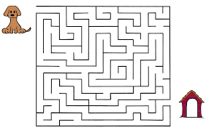
Stack and its Applications
Application of Stacks
Let us understand the use of stack by taking the case of “ Backtracking”.
Backtracking. This is a process when you need to access the most recent data element in a series of elements
To understand this we take analogy of a Maze.
Figure 2.1.13: Example of Backtracking using Maze
Notes:
When finding the way in a Maze we reach a dead end what do we do, we backtrack to a point from where we could make a choice for new way.
This could be implemented using stack where all choices at a choice point cold be stored on to stack. Then Backtracking simply means to pop a choice from stack and work accordingly.

Slide 34
Stack and its Applications
Application of Stacks
Expression evaluation
Backtracking (game playing, finding paths, exhaustive searching)
Memory management, run-time environment for nested language features
Delimiter Matching
System software and Compiler Design

Slide 35
Stack and its Applications
Applications of Stacks
Direct applications
Page-visited history in a Web browser
Undo sequence in a text editor
Chain of method calls in the Java Virtual Machine or C++ runtime environment
Indirect applications
Auxiliary data structure for algorithms
Component of other data structures

Slide 36
Stack and its Applications
Assignment I
Q1. Explain Stack in detail with the help of suitable example.
Q2. Write algorithms for PUSH, POP operations on stack.
Q3. Write a program in C Language to implement stack using arrays.
Q4. Write a program in C Language to implement stack using linked list.
Q5. Explain any one application of stack in detail.

Slide 37
Stack and its Applications
Recursion
Recursion is a method of solving problems that involves breaking a problem down into smaller and smaller subproblems until you get to a small enough problem that it can be solved trivially. Usually recursion involves a function calling itself. While it may not seem like much on the surface, recursion allows us to write elegant solutions to problems that may otherwise be very difficult to program.
Stack is not only used to perform recursion but any bunch of nested function calls.

Slide 38
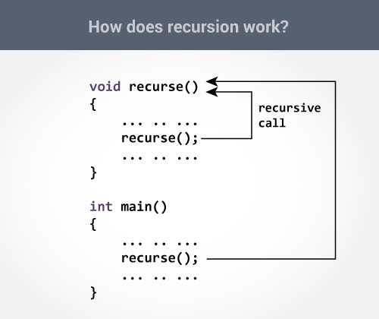
Stack and its Applications
Figure 2.1.14: Working of recursion
Notes:
The recursion continues until some condition is met to prevent it.
To prevent infinite recursion, if...else statement (or similar approach) can be used where one branch makes the recursive call and other doesn't.

Slide 39
Stack and its Applications
Example : Recursion
Let us take example of calculating factorial of a number using recursive approach. Code is implemented using C Language:
#include <stdio.h> int fact( int n)
void main() {
{ if (n <=1)
int m, res; return 1;
else
printf(“\nEnter the number :”); return m * fact(n-1);
scanf(“%d”,&m); }
res= fact(m);
printf(“\n Factorial of %d is %d”, m,res);
}

Slide 40
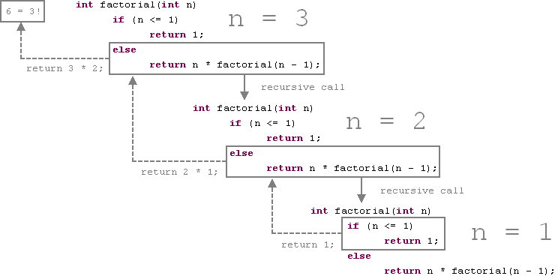
Stack and its Applications
Example : Recursion continued…
Figure 2.1.15: Call and return structure in Recursion

Slide 41
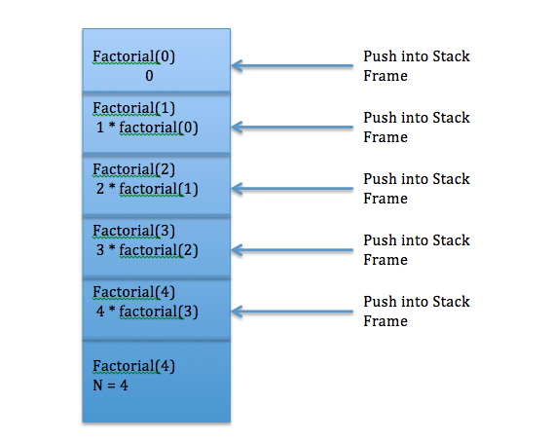
Stack and its Applications
Stack is used for internal implementation of Recursion
Figure 2.1.16: Use of stack internally to implement Recursion

Slide 42
Stack and its Applications
Quiz
1. Recursion is a method in which the solution of a problem depends on ____________ a) Larger instances of different problems b) Larger instances of the same problem c) Smaller instances of the same problem d) Smaller instances of different problems
2. Which of the following problems can be solved using recursion? a) Factorial of a number b) Nth fibonacci number c) Length of a string d) All of the mentioned
Notes:
Question Answer Key
1. c)
2. d)

Slide 43
Stack and its Applications
Quiz
3. Recursion is similar to which of the following? a) Switch Case b) Loop c) If-else d) None of the mentioned
4. In recursion, the condition for which the function will stop calling itself is ____________ a) Best case b) Worst case c) Base case d) There is no such condition
Notes:
Question Answer Key
3. b)
4. c)

Slide 44
Stack and its Applications
Quiz
5. What is the output of following code:
void my_recursive( int n)
{
if(n==0)
return;
printf(“%d”,n);
my_recursive(n-1);
}
int main()
{
my_recursive(10);
return 0;
}
Notes:
Question Answer Key
10 9 8 …. 1

Slide 45
Stack and its Applications
Evaluation of Arithmetic Expressions
The basic algorithm for handling arithmetic expressions without parentheses makes use of a data structure called a stack.

Slide 46
Stack and its Applications
POLISH NOTATIONS
Polish notation is a symbolic logic invented by Polish mathematician Jan Lukasiewicz.
Infix Notation
Prefix (Polish) Notation
Postfix (Reverse-Polish) Notation
Notes:
Infix Notation: It is easy for us humans to read, write and speak in infix notation but the same does not go well with computing devices.
Prefix Notation: Example +ab. This is equivalent to its infix notation a+b.
Postfix Notation: Example ab+. This is equivalent to its infix notation a+b.

Slide 47
Stack and its Applications
PARSING EXPRESSION
Precedence
Associativity
Postfix Evaluation Algorithm using stack
Notes:
Parsing Expressions
To parse any arithmetic expression, we need to take care of operator precedence and associativity also.
Precedence
For example: As multiplication operation has precedence over addition, b * c will be evaluated first.
Associativity
For example, in expression a+b−c, both + and − has same precedence, then which part of expression will be evaluated first, is determined by associativity of those operators.
Here, both + and − are left associative, so the expression will be evaluated as (a+b)−c.

Slide 48
Stack and its Applications
PARSING EXPRESSION continued….
Postfix Evaluation Algorithm using stack
We shall now look at the algorithm on how to evaluate postfix notation −
Step 1 − scan the expression from left to right
Step 2 − if it is an operand push it to stack
Step 3 − if it is an operator pull operand from stack and perform operation
Step 4 − store the output of step 3, back to stack
Step 5 − scan the expression until all operands are consumed
Step 6 − pop the stack and perform operation

Slide 49
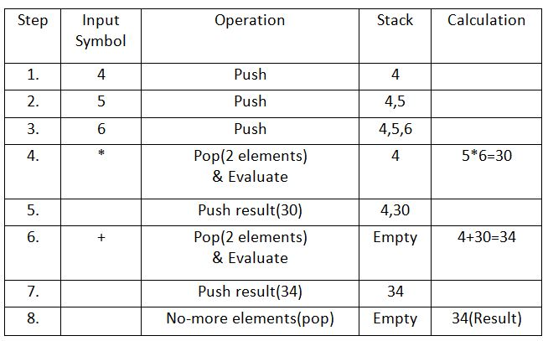
Stack and its Applications
Example: Postfix Evaluation using Stack
Postfix Expression: 4 5 6 * +
Table 2.1.1: Example of postfix evaluation using stack

Slide 50
Stack and its Applications
Quiz
7) In prefix notation ________ follows the operands. (fill in the blank)
8) A+B is an infix expression
True b)False
9) Postfix notation of A+B is
a) +AB c)AB+
b) A+B d)++A
Notes:
Question Number Answer key
7 Operator
8 a
9 c

Slide 51
Stack and its Applications
Conversion of Infix to Postfix Expression
Convert the infix form to postfix using a stack to store operators and then pop them in correct order of precedence.
Evaluate the postfix expression by using a stack to store operands and then pop them when an operator is reached.
Scan through an expression, getting one token at a time.

Slide 52
Stack and its Applications
Infix to postfix conversion
Use a loop to read the tokens one by one from a vector infixVect of tokens (strings) representing an infix expression. For each token do the following in the loop:
When the token is an operand
Add it to the end of the vector postfixVect of token (strings) that is used to store the corresponding postfix expression.
When the token is a left parenthesis “(”
Push_back the token x to the end of the vector stackVect of token (strings) that simulates a stack.
When the token is a right parenthesis “)”

Slide 53
Stack and its Applications
Repeatedly pop_back a token y from stackVect and push_back that token y to postfixVect until “(“ is encountered in stackVect. Then pop_back “(“ from stackVect.
If stackVect is empty before finding a “(“, that expression is not a valid expression.
When the token x is an operator
Write a loop that checks the following conditions:
The stack stackVect is not empty
The token y currently in the end of stackVect is an operator. In other words, it is not not a lef parenthesis “(“ .
y is an operator of higher or equal precedence than that of x

Slide 54
Stack and its Applications
As long as all the three conditions above are true, in the loop above repeatedly do the following in the body of the loop :
Call push_back to store a copy of the token y into postfixVect
Call pop_back to remove the token y from stackVect
Note: The loop above will stops as soon as any of the three conditions is not true. After the loop, push_back the token x into stackVect.
After the loop (in the previous slide) has processes all the tokens in infixVect and stop.
Use another loop to repeatedly do the following as long as the stack vector stackVect is not empty yet:
Call push_back to store a copy of the token on the top of the stack vector stackVect into postfixVect.
Call pop_back to remove the top token y from the stack vector.

Slide 55
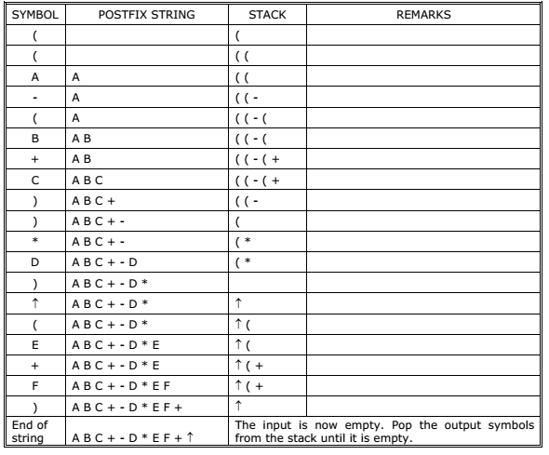
Stack and its Applications
Example: Conversion Infix to Postfix Notation using Stack
Convert ((A – (B + C)) * D) ↑ (E + F) infix expression to postfix form:
Table 2.1.2: Conversion Infix to Postfix Notation Example
Notes:
Explanation of example:
Step 1. First symbol in Input Expression is left parenthesis it is pushed on stack.
Step 2. Second Symbol in Input Expression is left parenthesis it is pushed on stack.
Step 3. Next Symbol in Input Expression is ‘A’ (operand) therefore it is placed in Output string
Step 4. Next Symbol in Input Expression is ‘-’ (operator) and symbol on top of stack is left parenthesis therefore it is pushed on stack.
Step 5. Next Symbol in Input Expression is left parenthesis therefore it is pushed on stack.
Step 6. Next Symbol in Input Expression is ‘B’ (operand) therefore it is placed in Output String
Step 7. Next Symbol in Input Expression is ‘+’ (operator) and symbol on top of stack is left parenthesis therefore it is pushed on stack.
Step 8. Next Symbol in Input Expression is ‘C’ (operand) therefore it is placed in Output String
Step 9. Next Symbol in Input Expression is ‘)’ right parenthesis therefore symbols from stack are poped and placed in Output string until Left parenthesis is encountered on top of stack. Therefore ‘+’ is poped and placed in Output string. Then left parenthesis is encountered on top of stack which then removed from stack but is not placed in output string.
Step 10. Next Symbol in Input Expression is ‘)’ right parenthesis therefore symbols from stack are poped and placed in Output string until Left parenthesis is encountered on top of stack. Therefore ‘-’ is poped and placed in Output string. Then left parenthesis is encountered on top of stack which then removed from stack but is not placed in output string.
Step 11. Next Symbol in Input Expression is ‘D’ (operand) therefore it is placed in Output string
Step 12. Next Symbol in Input Expression is ‘)’ right parenthesis therefore symbols from stack are poped and placed in Output string until Left parenthesis is encountered on top of stack. Left parenthesis is encountered on top of stack which then removed from stack but is not placed in output string.
Step 13. Next Symbol in Input Expression is ‘↑’ (operator) and symbol on top of stack is left parenthesis therefore it is pushed on stack.
Step 14. Next Symbol in Input Expression is left parenthesis therefore it is pushed on stack.
Step 15. Next Symbol in Input Expression is ‘E’ (operand) therefore it is placed in Output string
Step 16. Next Symbol in Input Expression is ‘+’ (operator) and symbol on top of stack is left parenthesis therefore it is pushed on stack.
Step 17. Next Symbol in Input Expression is ‘F’ (operand) therefore it is placed in Output string
Step 18. Next Symbol in Input Expression is ‘)’ right parenthesis therefore symbols from stack are poped and placed in Output string until Left parenthesis is encountered on top of stack. Therefore ‘+’ is poped from stack and placed in Output String. Then Left parenthesis is encountered on top of stack which then removed from stack but is not placed in output string.
Step 19. As the Input Expression is scanned and there are no more symbols in it to be scanned therefore symbols from stack are poped one at time and placed in Output string until stack is empty. Therefore ‘↑’ (operator) is poped from stack and placed on Output string.
Step 20. As stack is empty therefore procedure is complete and output string is the resultant Postfix expression

Slide 56
Stack and its Applications
Quiz
10) As per the algorithm to convert infix to postfix expression, we must ignore parenthesis present in infix expression
a) True b) False
11) While converting an infix expression to postfix expression, if an operator is encountered, the operators are ______
a) Pushed on to the stack c) Left without doing anything
b) Popped out of stack d) Checked for precedence level
12) When the string scanning ends, next operation is _________
a) Popping out all operators from stack and adding them to postfix string
b) Exit and print result
c) Push all the operands on to the stack
d) Do nothing
Notes:
Question No. Answer Key
10 a
11 a
12 a

Slide 57
Stack and its Applications
Assignment II
Q1. Write an algorithm for converting Unparenthesized Infix expression into Postfix expression.
Q2. Convert the following Infix expression into Postfix expression:
i) (A- B) * x + y / (F – C * E) + D
ii) A* (b + c) + (b/d) * a + z* U

Slide 58
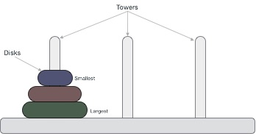
Stack and its Applications
Towers of Hanoi Problem
The Tower of Hanoi is a mathematical game or puzzle. The puzzle starts with the disks in a neat stack in ascending order of size on one rod, the smallest at the top, thus making a conical shape.
Figure 2.1.17: Schematic representation of Tower of Hanoi

Slide 59
Stack and its Applications
Tower of Hanoi
There are three towers:
64 gold disks, with decreasing sizes, placed on the first tower.
You need to move all of the disks from the first tower to the last tower.
Larger disks cannot be placed on top of smaller disks.
The third tower can be used to temporarily hold disks.
The disks must be moved within one week. Assume one disk can be moved in 1 second. Is this possible?
To create an algorithm to solve this problem, it is convenient to generalize the problem to the “N-disk” problem, where in our case N = 64.

Slide 60
Stack and its Applications
Tower of Hanoi
Notes:
To write an algorithm for Tower of Hanoi, first we need to learn how to solve this problem with lesser amount of disks, say → 1 or 2. We mark three towers with name, source, destination and aux (only to help moving the disks). If we have only one disk, then it can easily be moved from source to destination peg.
If we have 2 disks −
First, we move the smaller (top) disk to aux peg.
Then, we move the larger (bottom) disk to destination peg.
And finally, we move the smaller disk from aux to destination peg.

Slide 61
Stack and its Applications
Tower of Hanoi
Our ultimate aim is to move disk n from source to destination and then put all other (n1) disks onto it. We
can imagine to apply the same in a recursive way for all given set of disks.
The steps to follow are −
Step 1 − Move n-1 disks from source to aux
Step 2 − Move n^{th} disk from source to dest
Step 3 − Move n-1 disks from aux to dest

Slide 62
Stack and its Applications
Tower of Hanoi
A recursive algorithm for Tower of Hanoi can be driven as follows −
START
Procedure Hanoi(disk, source, dest, aux)
IF disk == 1, THEN
move disk from source to dest
ELSE
Hanoi(disk - 1, source, aux, dest) // Step 1
move disk from source to dest // Step 2
Hanoi(disk - 1, aux, dest, source) // Step 3
END IF
END Procedure
STOP

Slide 63

Stack and its Applications
Activity
Brief description of activity
Offline Activity ( 30 min)
Divide the students into 4 groups.
Below are 4 infix expression, assign an expression to each group.
Each group should convert the given expression to postfix and prefix expression using stack.
a. 3+4*5/6
b. 6 * (77 + 8 *15) + 20
c. (300+23)*(43-21)/(84+7)
d. (4+8)*(6-5)/((3-2)*(2+2))

Slide 64

Stack and its Applications
Summary
Stacks are Last-In-First-Out (LIFO) data structures in which the most recent element inserted in the stack is the first one to be removed.
The stack can be implemented using an array by creating a stack pointer variable for keeping track of top position.
Push () and pop () are the primary operations possible on stacks for insertion and deletion of elements along with some support functions.
Polish notation which is also called as prefix notation or simply prefix notation is a form of notation for logic, arithmetic, and algebra.
Infix notation is the most common and simplest notation in which an operator is placed between two operands.
In prefix notation, operator precedes operands and in postfix operands precedes the operator.
Stacks can be used for evaluating a postfix expression, also in Recursion, String reversal etc.

Slide 65
Stack and its Applications
Document Links
TOPICS | URL | Notes
The stack Abstract Data Type | http://interactivepython.org/runestone/static/pythonds/BasicDS/TheStackAbstractDataType.html | This link contains the Stack Abstract Data Type
Representation of Stack | http://www.c4learn.com/data-structure/stack-array-representation/ | This link contains the representation of stack
Operations of stack and applications | http://www.indiastudychannel.com/resources/140753-Stack-stack-operations-stack-application.aspx | This link contains the operations of stack, and its applications

Slide 66
Stack and its Applications
Video Links
TOPICS | URL | Notes
Representation of stack as an ADT | https://www.youtube.com/watch?v=XSdXSmwb550 | This link contains the representation of stack as an ADT
Representation of Stack | https://www.youtube.com/watch?v=Zo6ykuemNLc | This link contains the content of how to represent the stack
Infix to postfix conversion | https://www.youtube.com/watch?v=IAxCAbcqQFA | This link contains the conversion from infix to postfix

